Slide 1
MediaWiki
REPORT : MediaWiki Skins and Style

Slide 2
Key Aspects: To Get Started
Downloading
via git
Enabling
LocalSettings.php
Suppressing skins without installing
User CSS modification
“User:Username/style.css”

Slide 3
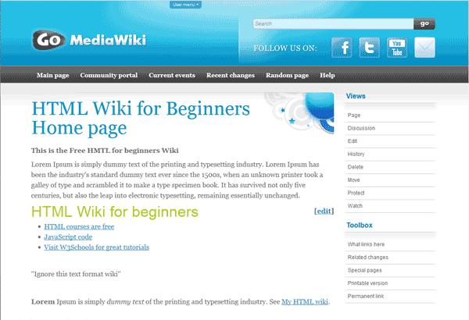
Advantages
BootstrapSkin
Typography
Buttons
Social buttons
BootStrap Prettify
And more…
Suppressing skins without installing
User CSS modification
No raw html input is required (formatting)
Div
Span and
ul tags
Should you wish to use them: <htmltag>

Slide 4
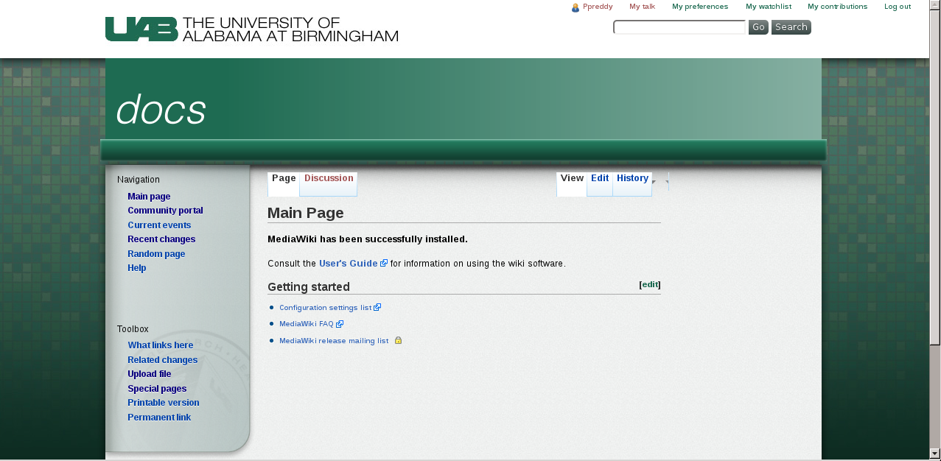
Disadvantages
Resources to support many of them, and have no real process for adding (or removing) skins
Installing a new skin, like a new extension, requires filesystem access
skins have very deep integration or shared/semi-shared code
…

Slide 5
Problems and Countermeasures
You see a Blank Page
error_reporting( E_ALL );
ini_set( 'display_errors', 1 );
Image Thumbnails not working and/or appearing
ensure $wgImageMagickConvertCommand variable is valid
JPEG
change $wgMaxImageArea value
And more, refer to https://www.mediawiki.org/wiki/Manual:Errors_and_symptoms

Slide 6
Thank you…
Questions?

